Slide 1
Deformation of Metals

Slide 2
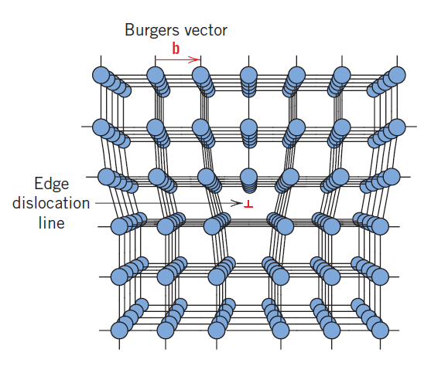
Dislocations
Edge and screw are the two fundamental dislocation types
In an edge dislocation, localized lattice distortion exists along the end of an extra half-plane of atoms, which also defines the dislocation line

Slide 3
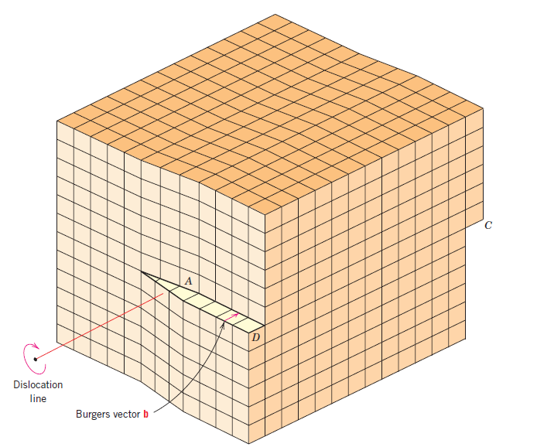
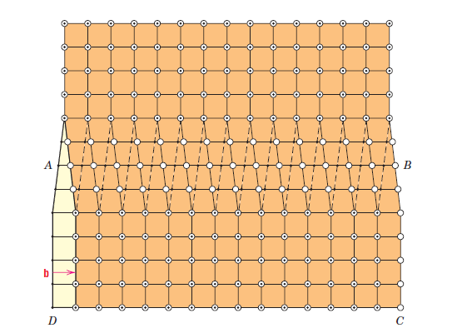
screw dislocation, exists, which may be thought of as being formed by a shear stress that is applied to produce the distortion.

Slide 4
Plastic Deformation
Plastic deformation is permanent, and strength and hardness are measures of a material’s resistance to this deformation.
Plastic deformation corresponds to the net movement of large numbers of atoms in response to an applied stress.
Plastic deformation most often involves the motion of dislocations in crystalline solids.

Slide 5
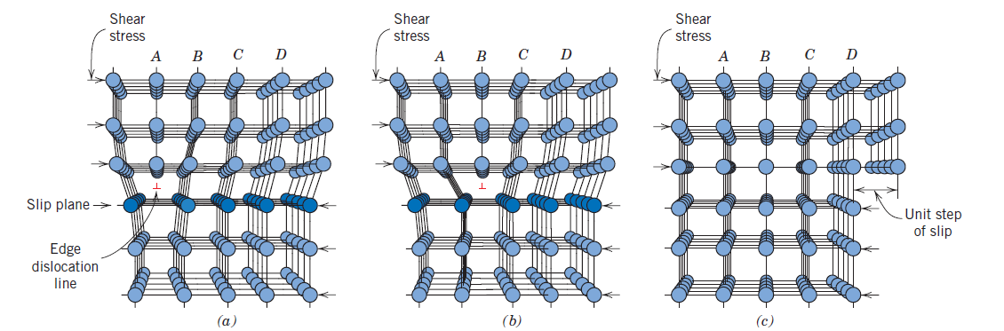
An edge dislocation moves in response to a shear stress applied in a direction perpendicular to its line; the mechanics of dislocation motion are represented in Fig

Slide 6
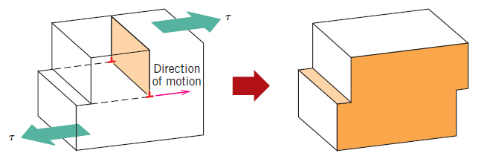
The process by which plastic deformation is produced by dislocation motion is termed slip.
The crystallographic plane along which the dislocation line traverses is the slip plane, it follows that the direction of movement is called the slip direction.
This combination of the slip plane and the slip direction is termed the slip system.

Slide 7
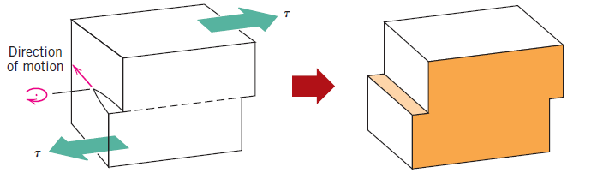
The motion of a screw dislocation in response to the applied shear stress is shown in Figure
For an edge, motion is parallel to the shear stress. However, the net plastic deformation for the motion of both dislocation types is the same
The direction of motion of the mixed dislocation line is neither perpendicular nor parallel to the applied stress, but lies somewhere in between.

Slide 8
SLIP SYSTEMS
For a particular crystal structure, the slip plane is the plane that has the most dense atomic packing - greatest planar density.
The slip direction corresponds to the direction, in this plane, that is most closely packed with atoms - highest linear density

Slide 9
Slip system for FCC

Slide 11
DEFORMATION BY TWINNING
In addition to slip, plastic deformation in some metallic materials can occur by the formation of mechanical twins, or twinning.
A twin boundary is a special type of grain boundary across which there is a specific mirror lattice symmetry
Twins result from
atomic displacements that are produced from applied mechanical shear forces called mechanical twins observed in BCC and HCP.
and also during annealing heat treatments following deformation called annealing twins typically found in FCC.

Slide 12
The amount of bulk plastic deformation from twinning is normally small relative to that resulting from slip. However, the real importance of twinning lies with the accompanying crystallographic reorientations; twinning may place new slip systems in orientations that are favorable relative to the stress axis such that the slip process can now take place.

Slide 13
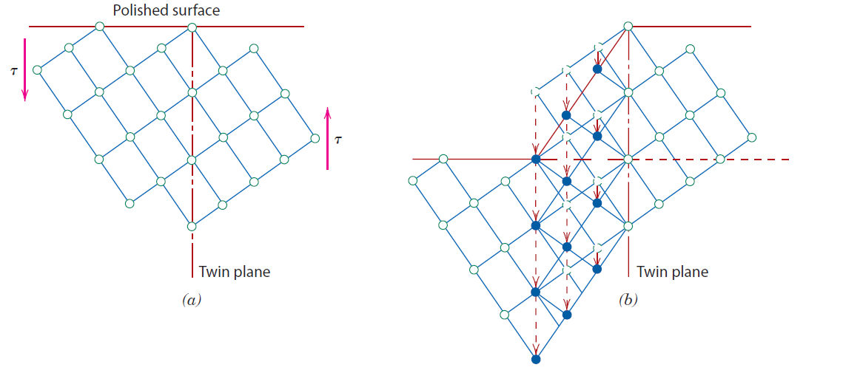

Slide 14
Mechanisms of Strengthening in Metals
Important to the understanding of strengthening mechanisms is the relation between dislocation motion and mechanical behavior of metals.
The ability of a metal to plastically deform depends on the ability of dislocations to move.
Virtually all strengthening techniques rely on this simple principle: restricting or hindering dislocation motion renders a material harder and stronger.

Slide 15
STRENGTHENING BY GRAIN SIZE REDUCTION
The size of the grains, or average grain diameter, in a polycrystalline metal influences the mechanical properties.
The grain boundary acts as a barrier to dislocation motion due to:
Since the two grains are of different orientations, a dislocation passing into grain B will have to change its direction of motion; this becomes more difficult as the crystallographic misorientation increases.
The atomic disorder within a grain boundary region will result in a discontinuity of slip planes from one grain into the other.

Slide 16
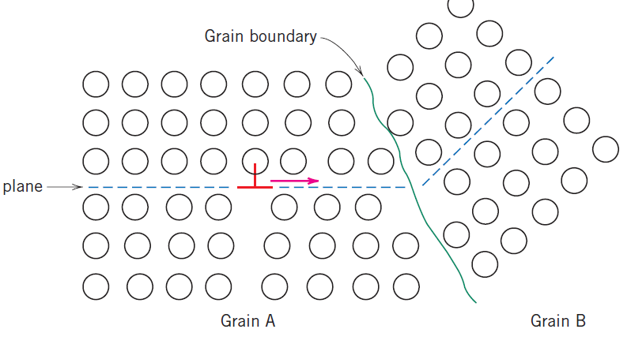

Slide 17
for high-angle grain boundaries, it may not be the case that dislocations traverse grain boundaries during deformation; rather, dislocations tend to “pile up” (or back up) at grain boundaries.
These pile-ups introduce stress concentrations ahead of their slip planes, which generate new dislocations in adjacent grains
A fine-grained material (one that has small grains) is harder and stronger than one that is coarse grained, since the former has a greater total grain boundary area to impede dislocation motion.

Slide 18
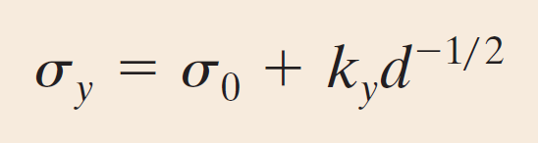
termed the Hall-Petch equation
Grain size may be regulated by the rate of solidification from the liquid phase, and also by plastic deformation followed by an appropriate heat treatment.
grain size reduction improves not only strength, but also the toughness of many alloys.
Small-angle grain boundaries (Section 4.6) are not effective in interfering with the slip process because of the slight crystallographic misalignment across the boundary.

Slide 19
SOLID-SOLUTION STRENGTHENING
Another strengthening method is alloying with impurity atoms that go into either substitutional or interstitial solid solution.
High-purity metals are almost always softer and weaker than alloys composed of the same base metal.
impurity atoms that go into solid solution ordinarily impose lattice strains on the surrounding host atoms.

Slide 20
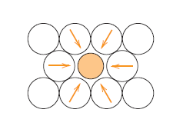
an impurity atom that is smaller than a host atom for which it substitutes exerts tensile strains on the surrounding crystal lattice
a larger substitutional atom imposes compressive strains in its vicinity
These solute atoms tend to diffuse to and segregate around dislocations in a way so as to reduce the overall strain energy

Slide 21
A smaller impurity atom is located where its tensile strain will partially nullify some of the dislocation’s compressive strain.
The resistance to slip is greater when impurity atoms are present because the overall lattice strain must increase if a dislocation is torn away from them.

Slide 22
the same lattice strain interactions will exist between impurity atoms and dislocations that are in motion during plastic deformation.

Slide 23
STRAIN HARDENING
Strain hardening is the phenomenon whereby a ductile metal becomes harder and stronger as it is plastically deformed.
Sometimes it is also called work hardening
because the temperature at which deformation takes place is “cold” relative to the absolute melting temperature of the metal, it is called cold working.

Slide 24
It is convenient to express the degree of plastic deformation as percent cold work
The price for enhancement of hardness and strength is in the ductility of the metal.

Slide 26
The strain-hardening phenomenon is explained on the basis of dislocation–dislocation strain field interactions.
The dislocation density in a metal increases with deformation or cold work, due to dislocation multiplication or the formation of new dislocations.
the average distance of separation between dislocations decreases .
The net result is that the motion of a dislocation is hindered by the presence of other dislocations.

Slide 27
As the dislocation density increases, this resistance to dislocation motion by other dislocations becomes more pronounced.
Thus, the imposed stress necessary to deform a metal increases with increasing cold work.

Slide 28
Recovery, Recrystallization, and Grain Growth
During recovery, some of the stored internal strain energy is relieved by virtue of dislocation motion due to enhanced atomic diffusion at the elevated temperature.
There is some reduction in the number of dislocations and dislocation configurations are produced having low strain energies
Recrystallization is the formation of a new set of strain-free and equiaxed grains that have low dislocation densities and are characteristic of the precold-worked condition.

Slide 29
The driving force to produce this new grain structure is the difference in internal energy between the strained and unstrained material.
during recrystallization, the mechanical properties that were changed as a result of cold working are restored to their precold-worked values
Recrystallization is a process the extent of which depends on both time and temperature.

Slide 30
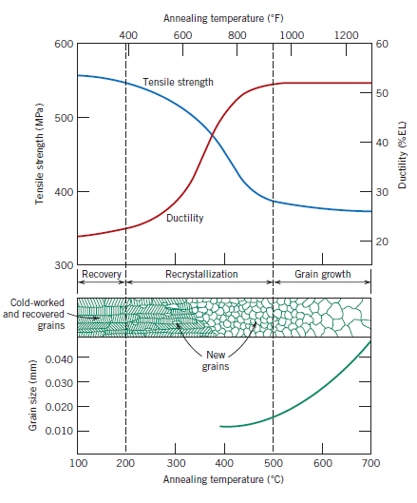

Slide 31
recrystallization temperature is the temperature at which recrystallization just reaches completion in 1 h.
Typically, it is between one-third and one-half of the absolute melting temperature of a metal or alloy.
It depends on the following factors
amount of prior cold work
purity of the alloy
Increasing the percentage of cold work enhances the rate of recrystallization

Slide 32
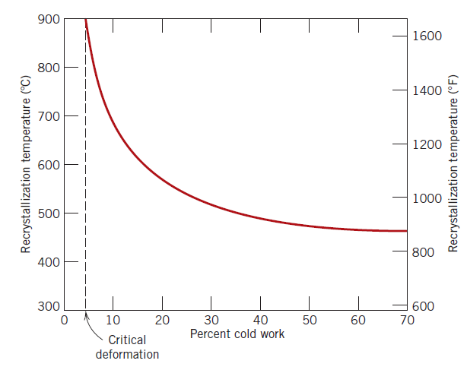
There exists some critical degree of cold work below which recrystallization cannot be made to occur

Slide 33
Recrystallization proceeds more rapidly in pure metals than in alloys.
After recrystallization is complete, the strain-free grains will continue to grow if the metal specimen is left at the elevated temperature-this phenomenon is called grain growth.
As grains increase in size, the total boundary area decreases, yielding an attendant reduction in the total energy which is the driving force for grain growth.
Grain growth occurs by the migration of grain boundaries.

Slide 34
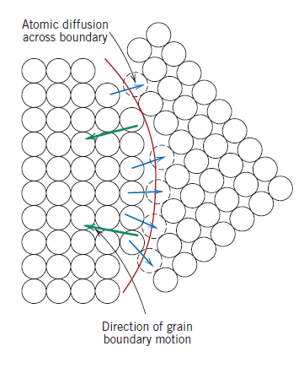
Not all grains can enlarge, but large ones grow at the expense of small ones that shrink.
Boundary motion is just the short-range diffusion of atoms from one side of the boundary to the other.

Slide 35
The mechanical properties at room temperature of a fine-grained metal are usually superior to those of coarse-grained ones.

Slide 36
Plastic deformation operations are often carried out at temperatures above the recrystallization temperature in a process termed hot working
The material remains relatively soft and ductile during deformation because it does not strain harden, and thus large deformations are possible.

Slide 37
PRECIPITATION HARDENING
The strength and hardness of some metal alloys may be enhanced by the formation of extremely small uniformly dispersed particles of a second phase within the original phase matrix
Examples of alloys that are hardened by precipitation treatments include aluminum–copper, copper–beryllium, copper–tin, and magnesium–aluminum and some ferrous alloys

